Slide 1
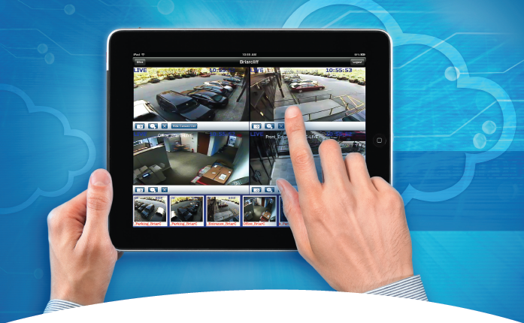
MAXPRO® Cloud Solution
Notes:
We’re seeing the change in communications paths and methods for our alarm systems. We’ve seen the advent of apps. Price and margin erosion like never before the IP transition, or revolution as many people call it
And we’ve seen the advent of a suite of services offerings that people refer to as cloud services – things like
VaaS
SaaS
PaaS
Whether you are using these technologies today, or taking advantage of them to drive more business, it’s important that you understand how they can help your business grow and be more profitable.
Now more than ever, you ability to understand these technologies will have a profound impact on how you do business.

Slide 2
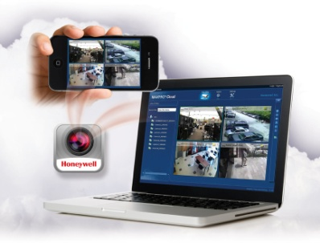
What is MAXPRO Cloud?
Honeywell Hosted Video Service allows customers to access their video anytime, anywhere there is an internet connection.
It allows integrators to reduce installation and services costs while generating recurring monthly revenue and improving maintenance contract values.
Cloud Hosted Video Service Platform
Provides anytime, anywhere access to video
Cloud Storage will reduce installation and service costs
Generates Recurring Monthly Revenue (RMR) from video services
Notes:
- 1st Time we have offered any exclusivity for these programs.
- Builds the value of our dealer programs
So how is Honeywell helping set dealers up for success to meet this demand for services and access to information?
I’d like to take this opportunity to introduce the Maxpro cloud solution offering.
What is it exactly? Maxpro Cloud is a hosted application that involves our industry leading software application and our edge hardware appliance.
It’s designed with your needs in mind to decrease the overall cost of installation while creating a host of new service offerings
This solution enables anytime, anywhere access to their video for your customers

Slide 3
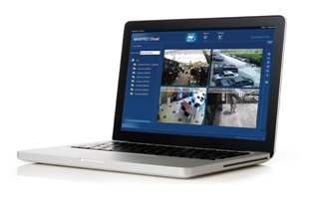
Why did Honeywell develop MAXPRO Cloud?
Values and Benefits for Installer/Integrator…
Drive Long-Term Business Value
  RMR generation from Hosted Video Services
  Improve overall business value
Reduce Installation and Service Time & Costs
  MAXPRO Connect Reverse Initiate and UPnP reduces time on site
  Business applications are no longer part of the customers network
  Proactive monitoring sends notification of system alarms and events
  Update/upgrade all customer units without having to go directly to the site
Minimal Investment and Complexity
  No upfront equipment investment for hosted video services
  No special IT skills or long training required
Keeps Customers Longer
  Meet customer demand for access to their video anytime, anywhere
  Stay ahead of the competition with a partner that can provide full security solution in the cloud
Notes:
MAXPRO Cloud gives dealers stickiness, by controlling the access to customers video.
Why would a dealer ever install another video system that doesn’t get them RMR

Slide 4
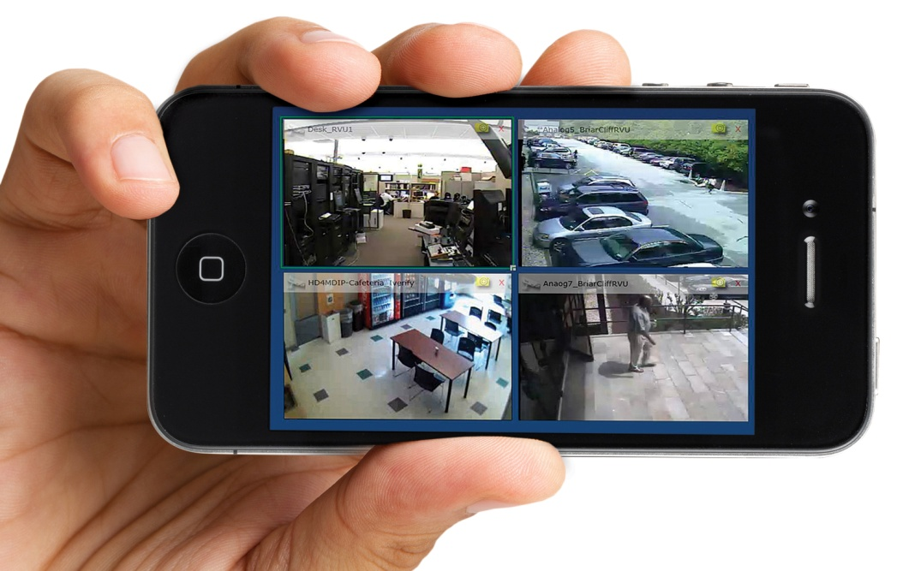
Why did Honeywell develop MAXPRO Cloud?
Values and Benefits for End User…
Access Video Anytime, Anywhere
  Easy access to live and recorded video from any Internet connected PC or Device
  No special IT skills required to access video outside of company firewall or intranet
  User only pays for what he gets, so he spends on OP.EX. not CAP.EX. - easier to add new services
Meet Needs Now and in the Future
  Automatic updates for new features and service packs without a service call
  Scalable storage options - buy what you need, when you need it
  Hybrid design allows lets users protect their existing investment
Advanced Video Management without the Investment
  View multiple cameras from multiples sites with a single user login
  Connect multiple sites together to form a virtual video network
Peace of Mind for End-Users
  MAXPRO Cloud monitors their system, even when they don’t
  Know their video will be there for them when they need it most

Slide 5
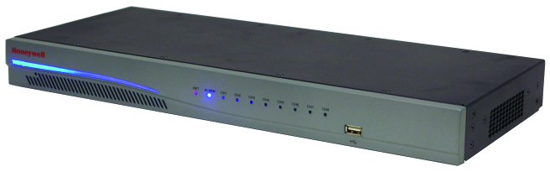
MaxproCloud Appliance: HRRH8X – Phase1
The appliance: Local hybrid encoder with a selectable mix of 8 analogue and IP Channels (up to 4 IP PoE inputs) with local storage up to 4TB. Access to Live view and on-site recorded video (Search & Playback) over the Internet using a PC, iPhone & iPad devices.
Key features:
  Easily expandable local storage On-Board (4GB) or USB drives (up to 1TB) or NAS storage (up to 4TB). Approved NAS systems list is in the Appendix.
  IP Cameras Supported:
  HCD554IPX (HCS554IPX) and HD4DIPX (EQUIP)
  HD3MDIPX and HD4MDIPX (720p)
  HCD5MIHX, HD3MDIHX and HD4MDIHX (720p H.264)
  HD44IPX, HD451PX, HD54IPX and HD55IPX (Performance range)
  No software to purchase, install or maintain:
    Web-based software interface and MAXPRO Mobile for iPhone and iPad.
    Hosting server that allows customers to access their video (Live and Playback) anytime, anywhere there is an internet connection with multi-view and multi-site video display from a single login.

Slide 6
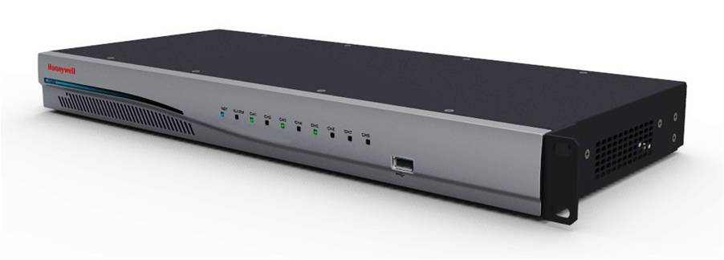

MAXPRO Cloud: the Appliance
Power LED Bar
8 Channel LEDs Showing Channel Status/ Alarm/Network
USB 2.0
Connection
Sleek 1U Design
Local Video
Monitor Output
Alarm IP/OP
RS232
Port
4 RJ45 PoE IP connections
8 Analog BNC I/P
Audio In/Out
2 RJ45 Network Ports
48V Power

Slide 7
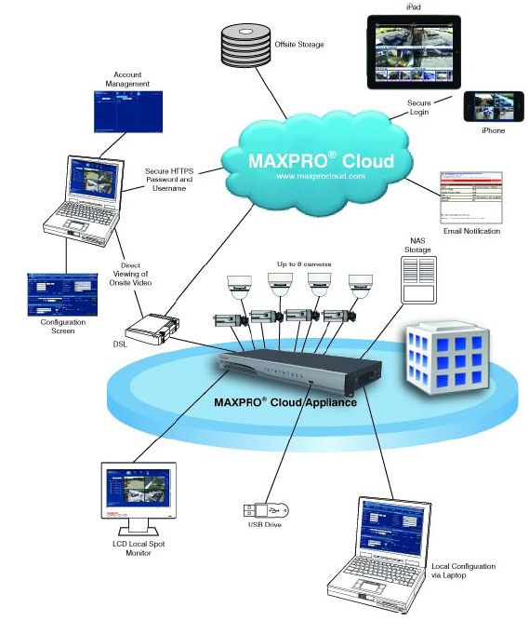
Maxpro Cloud: System Diagram – Phase 1
Available in Q1 2013
View from anywhere and at anytime via standard web browser:
  Display and access multiple sites automatically based on user privilege
  Drag and drop cameras into viewing windows
  View live video display a single camera or quad view with different salvos
Easy one-click search/review of recorded events/clips
Easy local capture and export of snapshots and video clips
Local export of onsite recording clips to USB and Review evidence clips using any standard video players
Remote export of recording clips will be available in Phase 2 (Q1 -2013)
Secure HTTPS login
Quick link feature and review of events

Slide 8
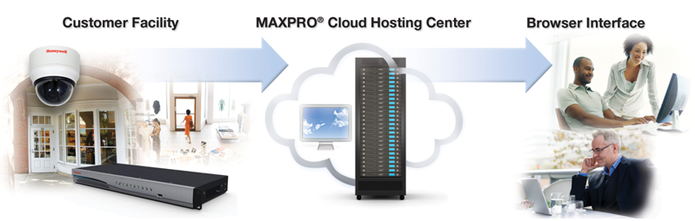
Hosted Services: Overview
Hosted Services
System Health Check
User Management
Hosted Web GUI
Automatic Feature and Security Updates
Alarm / Event Notification
  Smart Video Motion Detection
  Arm/Disarm Events
  Input Point Alarms
  System Health
Camera power loss
Camera failure
MPC Health Check
Communications Monitoring
Power Fail Detection
Proactive Servicing
  Email Notification to User and/or Dealer Q1/’13
Web Browser Interface
Multi-View Video Display
Remote Video Look-in
Multi-Site Viewing
Off-Site Storage Option Q1/’13
Advanced Search Function
Download Clips/Snapshot Q1, 2013
Mobile Video Access
(iPad and iPhone)

Slide 9
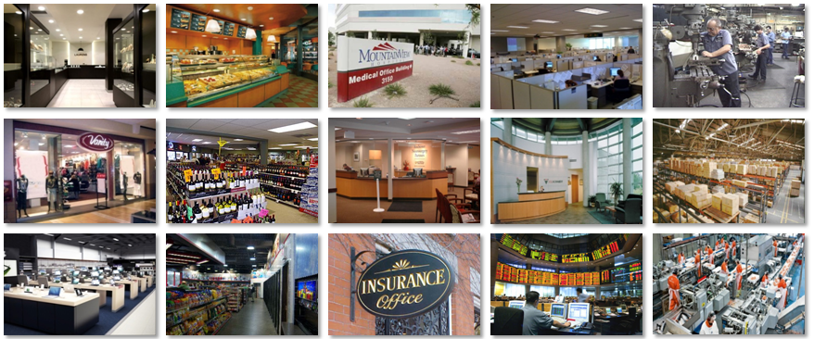
Target Customer Segments
Retail
Quick
Service
Professional
Services
Small
Commercial
Manufacturing /
Warehousing
Single or Multi-Site Applications
Notes:
Why are these target segments?
No IT on staff
Security is not their primary business, only responds to an event after the fact and only if it is known
Need to access video outside of facility
Want awareness even when they are not watching their system

Slide 10
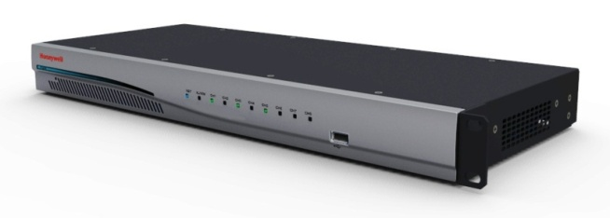
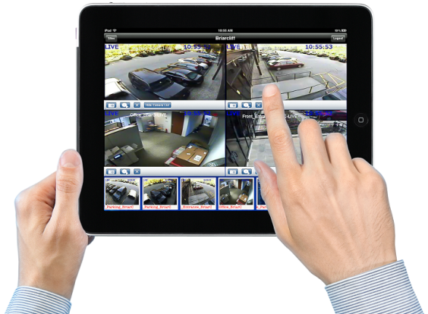
System Pricing Options – Direct only Phase 1
MAXPRO Cloud Appliance £ 810 Str Low no price available for ADI yet € 900 Str Low
  8 Channels IP or analog
  4 channels of POE
  4 GB solid state onboard storage
  USB & NAS storage (purchased separately)
  Smart VMD on 4 analogue inputs
  3 Year warranty
Basic Hosting Service No Charge
  Anytime, Anywhere Access via Internet
  Search & Playback and local video Export
  Mobile Application Support
  Multiple Account Management
  Automatic System Updates
  MAXPRO Connect

Slide 11


System Pricing Options – Phase 2
a small fee x month
Real-Time Notifications
  Email on Events and Alarms (local storage)
    Event duration: from 30 to 300 seconds
  Email with video clip link
  System Health Notification
    Camera VideoLoss and Power Fail
    Lost Communications
    Local Recording Device Fail
  Available in Q1 2013
Cloud Storage a small fee x month
  Scalable Event Clips Storage packages:
    From 3 to 100 number of clips per day per unit
    From 100 to 3000 max number of clips (10MB each)
    Clip’s duration from 30 secs to 300 secs (Res. dependant)
  From 1GB to 30GB Storage retention for all Cameras (max 30 Days period)
  Available in Q1 2013

Slide 12
MAXPRO® Cloud Menu
Features _______ Package Name & P/N | Live View from anywhere anytime | Snapshot I/O Control | Search and playback video | VideoClip Export | Mobile Access Apps | Account Manage-ment & Setup | Smart VMD (analog inputs only) | MAXPRO Portal | Email on Events | Email with Clip link | Personalized GUI | Cloud Storage | Number of Clips per Day per Unit | Max number of Clips | Max Storage Retention in Days | Dealer price per month | Dealer Price selecatable per package | End-User price per month | PACKAGE details
 | Package available with initial launch in November 2012 (Phase 1)
Base MPCB | Yes | Yes | Yes | Yes | Yes | Yes | Yes (up to 4 ch) | Yes | No | No | No | No |  |  |  | FREE |  | FREE | Regular Hybrid NVR no additional connection fee
 | Packages available with next launch in Q1 2013 (Phase 2)
Standard MPCS | Yes | Yes | Yes | Yes | Yes | Yes | Yes (up to 4 ch) | Yes | Yes | No | No | No |  |  |  | € 12.00 |  | € 12.00 | Full remote email configuration & Event monitoring
Event MPCE | Yes | Yes | Yes | Yes | Yes | Yes | Yes (up to 4 ch) | Yes | Yes | Yes | No | No |  |  |  | € 16.00 |  | € 16.00 | Full Event Configuration with Clip storage
Premium MPCxxxC | Yes | Yes | Yes | Yes | Yes | Yes | Yes (up to 4 ch) | Yes | Yes | Yes | Yes | Yes |  |  |  | € 20.00 |  | € 20.00 | Email & Event configuration with Off-Site Storage
 |  |  |  |  |  |  |  |  | Selectable per Unit storage options |  |  | MPC300C | 10 | 300 | 30 |  | € 4.00
 |  |  |  |  |  |  |  |  |  |  |  | MPC600C | 20 | 600 | 30 |  | € 8.00
 |  |  | Maxpro Cloud Unit HRRH8X Net Price: € 900.00 |  |  |  |  |  |  |  |  | MPC1200C | 40 | 1200 | 30 |  | € 12.00
 |  |  |  |  |  |  |  |  |  |  |  | MPC2400C | 80 | 2400 | 30 |  | € 20.00
 |  |  |  |  |  |  |  |  |  |  |  | MPC3600C | 120 | 3600 | 30 |  | € 30.00
 |  |  |  |  |  |  |  |  |  |  |  | MPC4800C | 160 | 4800 | 30 |  | € 40.00
 |  |  |  |  |  |  |  |  |  |  |  | Additional | + | + | + |  | € xxx
Preliminary
prices

Slide 13
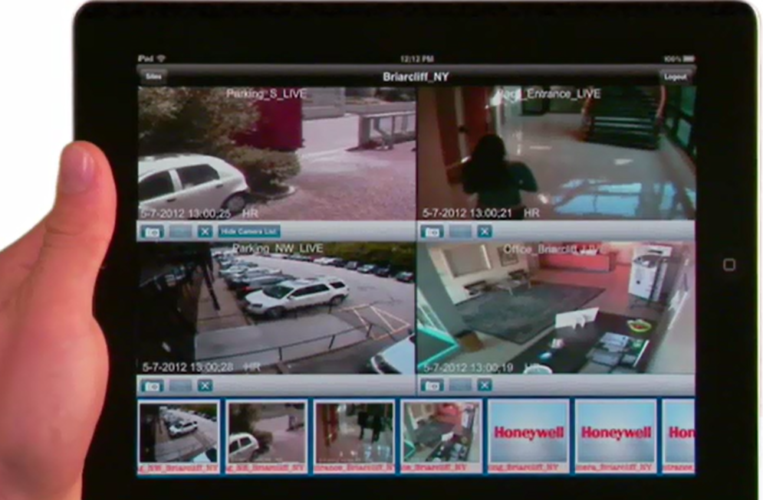
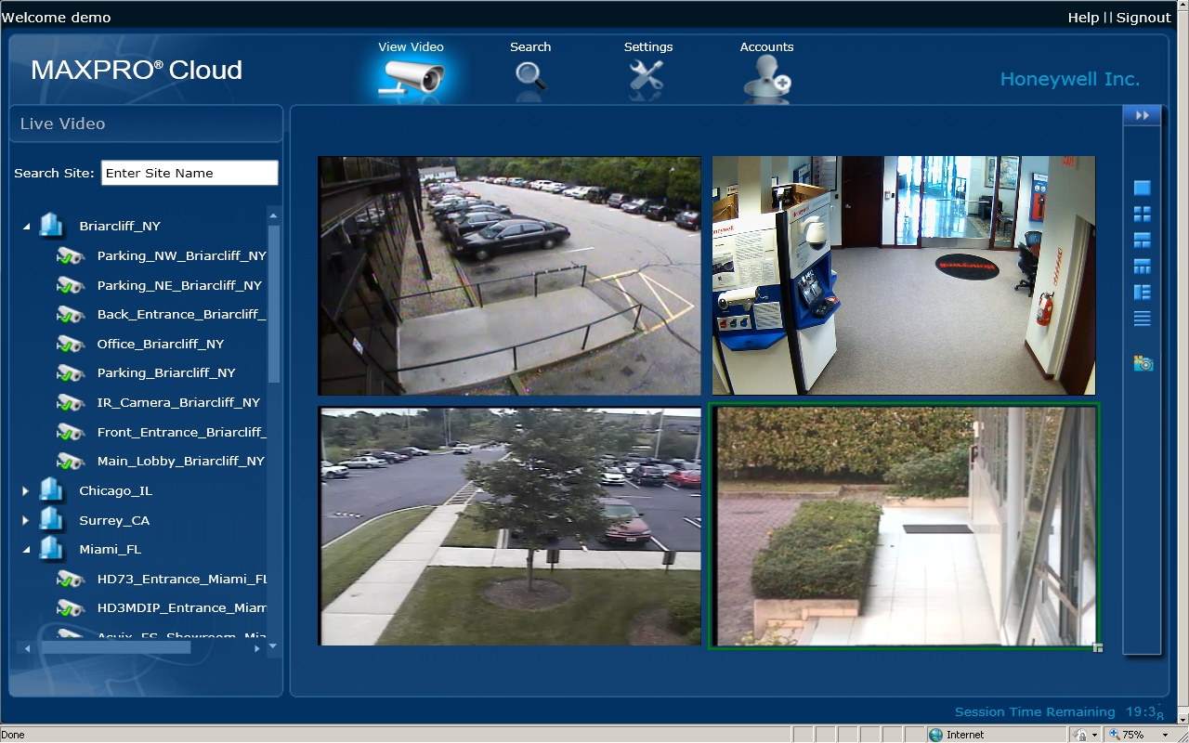
MAXPRO Cloud Software and iOS Apps
USA/EMEA demo sites: www.maxprocloud.com/login
User ID: demo
Password: demo

Slide 14
Why Cloud technology?
Reduce Installation and Service Time & Costs
  Reduces time on site
  Proactive monitoring sends notification of system alarms and events
  Update/upgrade all customer units without having to go directly to the site
Minimal Investment and Complexity
  No software to purchase & maintain
  No upfront equipment investment for hosted video services
  No special IT skills or long training required
Keeps Customers Longer
  Meet customer demand for access to their video anytime, anywhere
Drive Long-Term Business Value for Installers
  RMR generation from Hosted Video Services
  Improve overall business value
Notes:
MAXPRO Cloud gives dealers stickiness, by controlling the access to customers video.
Why would a dealer ever install another video system that doesn’t get them RMR

Slide 15
Why Honeywell?
Most flexible hardware solution
  Hybrid encoder with mix of analogue and IP Channels
    legacy conversion capability
  SMART Video Motion Detection feature
Remote emailing of video clips (Q1, 2013)
  From base packages
Most flexible storage options
  local: SD card / USB drive / NAS device
  flexible Cloud storage packages (Q1, 2013)
Facewatch relationship
Notes:
What makes our solutions different? Let’s start with a few things
what other system offers you the flexibility in recording?
on site direct
on site network
off site cloud
what other systems allows full scalability up to an Enterprise cloud solution?

Slide 16

Questions?
THANK YOU
ANNEX
and Q/A

Slide 17
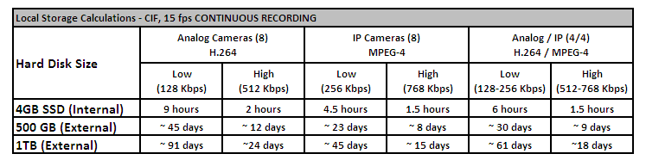
Local Storage Options
Local Recording Options
  4GB Internal
  Up to 1 TB External Off-the-Shelf USB Drive
  Up to 4 TB External NAS Storage Drive
Remote Recording Available Q1 2013
Note: For event-based recording (pre-event – 30 sec, post-event – 120 sec), storage required will be one sixth of continuous recording (assuming 100 events/day).

Slide 18
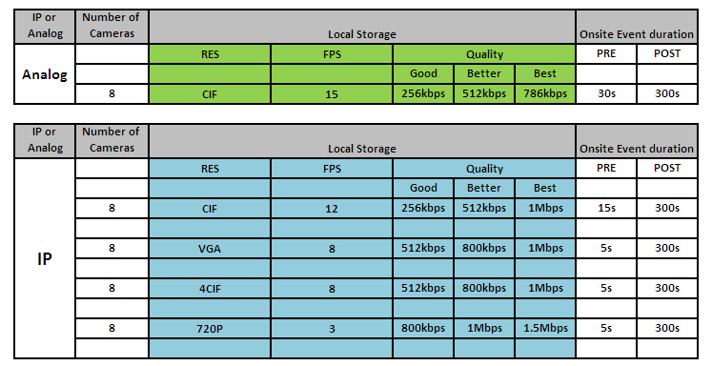
Recording Capabilities

Slide 19
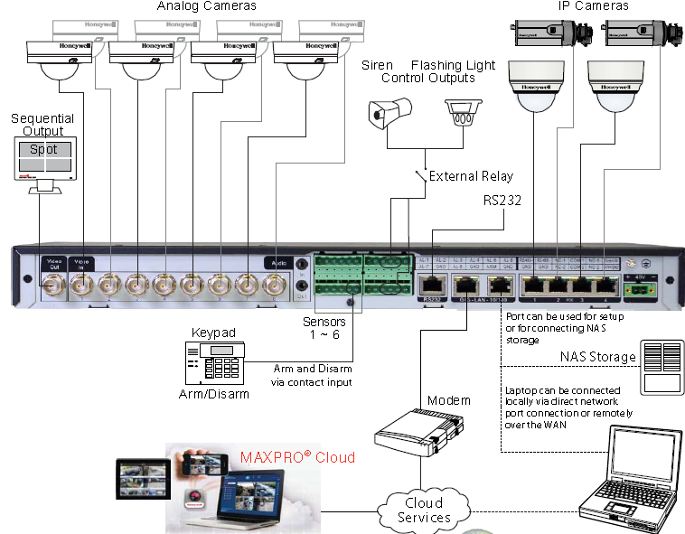
Unit Connections

