Slide 1
MAXPRO® Cloud Appliance
HSG EMEA Kick-Off 2013
Redo Bezzo

Slide 2
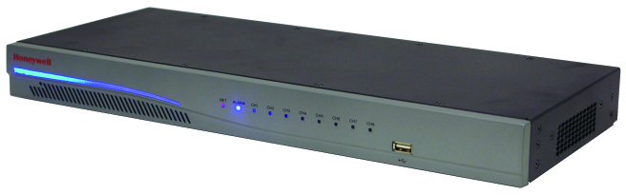
MAXPRO® Cloud Appliance – Phase 1
MPC appliance is:
  a local hybrid encoder with a selectable mix of 8 analogue and IP inputs
MPC appliance allows:
  Live view, Search & Playback of on-site recorded video and Export snapshots & clips over the Internet using a PC, iPhone & iPad devices.
Key features and benefits:
  Easily expandable local storage On-Board (4GB) or USB drives (1TB) or NAS storage (up to 4TB)
  All EQUIP, Performance and Hon 720p IP Cameras are supported
  Easy to install: auto-connection function to Cloud Server and
  remote update/upgrade of any customer unit
  Legacy conversion capability → easy migration to IP from existing analogue system
  No software to purchase, install or maintain → reduce services and maintenance costs

Slide 3
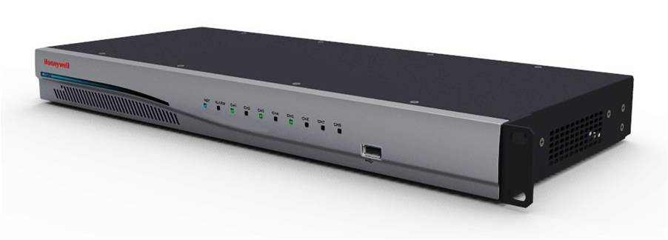

MAXPRO® Cloud: HRRH8X the Appliance
Power LED Bar
8 Channel LEDs Showing Channel Status/ Alarm/Network
USB 2.0
Connection
Sleek 1U Design
Local Video
Monitor Output
4 RJ45 PoE IP connections
Alarm IP/OP
RS232
Port
8 Analog BNC Inputs
Audio In/Out
2 RJ45 Network Ports
48V Power

Slide 4
MAXPRO® Cloud Solution
HSG EMEA Kick-Off 2013
Redo Bezzo

Slide 5
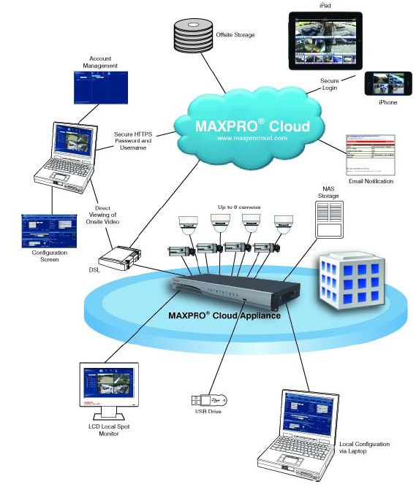
MAXPRO® Cloud: System Diagram
Available in Q1 2013
View from anywhere and at anytime via standard web browser and mobile devices:
  Display and access multiple sites automatically based on user privilege
  Drag and drop cameras into viewing windows
  View live video display of a single camera or quad view with different salvos
Easy one-click search/review of recorded events/clips and local capture and export of snapshots and video clips
Remote export of on-site video clips to PC or to local USB and Review evidence clips using any standard video players
Secure HTTPS login
Remote export of off-site video clips will be available in Phase 2 (Q1 -2013)
Available in Q1 2013

Slide 6
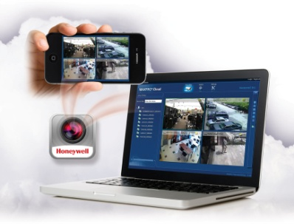
MAXPRO® Cloud Solution – Phase 2 (Q1-2013)
MPC solution is:
  Remote “cloud-ready” hybrid NVR with a suite of Hosted Video Services
MPC solution allows:
  the user to access to Live view and to both on-site & off-site recorded video (Search & Playback and Export) over the Internet using a PC, iPhone & iPad devices.
Key features and benefits:
    Automatic connection to hosting Server with a wide Hosting Services suite (Cloud Storage, Email notification on event or with Clip link, customized GUI,…)
    RMR generation opportunity from Hosted Video Services → Improve entire business value
    Flexible Cloud Storage options with different size & cost→ it will reduces the risk of ‘smash & grab’ or lost Video
    Full Honeywell IP camera support (WDR and 1080p included) and PSIA/ONVIF support

Slide 7
MAXPRO® Cloud Menu
Features _______ Package Name & P/N | Live View from anywhere anytime | Snapshot I/O Control | Search and playback video | VideoClip Export | Mobile Access Apps | Account Manage-ment & Setup | Smart VMD (analog inputs only) | MAXPRO Portal | Email on Events | Email with Clip link | Personalized GUI | Cloud Storage | Number of Clips per Day per Unit | Max number of Clips | Max Storage Retention in Days | Dealer price per month | Dealer Price selecatable per package | End-User price per month | PACKAGE details
 | Package available with initial launch in November 2012 (Phase 1)
Base MPCB | Yes | Yes | Yes | Yes | Yes | Yes | Yes (up to 4 ch) | Yes | No | No | No | No |  |  |  | FREE |  | FREE | Regular Hybrid NVR no additional connection fee
 | Packages available with next launch in Q1 2013 (Phase 2)
Standard MPCS | Yes | Yes | Yes | Yes | Yes | Yes | Yes (up to 4 ch) | Yes | Yes | No | No | No |  |  |  | € 12.00 |  | € 12.00 | Full remote email configuration & Event monitoring
Event MPCE | Yes | Yes | Yes | Yes | Yes | Yes | Yes (up to 4 ch) | Yes | Yes | Yes | No | No |  |  |  | € 16.00 |  | € 16.00 | Full Event Configuration with Clip storage
Premium MPCxxxC | Yes | Yes | Yes | Yes | Yes | Yes | Yes (up to 4 ch) | Yes | Yes | Yes | Yes | Yes |  |  |  | € 20.00 |  | € 20.00 | Email & Event configuration with Off-Site Storage
 |  |  |  |  |  |  |  |  | Selectable per Unit storage options |  |  | MPC300C | 10 | 300 | 30 |  | € 4.00
 |  |  |  |  |  |  |  |  |  |  |  | MPC600C | 20 | 600 | 30 |  | € 8.00
 |  |  | Maxpro Cloud Unit HRRH8X Net Price: € 900.00 |  |  |  |  |  |  |  |  | MPC1200C | 40 | 1200 | 30 |  | € 12.00
 |  |  |  |  |  |  |  |  |  |  |  | MPC2400C | 80 | 2400 | 30 |  | € 20.00
 |  |  |  |  |  |  |  |  |  |  |  | MPC3600C | 120 | 3600 | 30 |  | € 30.00
 |  |  |  |  |  |  |  |  |  |  |  | MPC4800C | 160 | 4800 | 30 |  | € 40.00
 |  |  |  |  |  |  |  |  |  |  |  | Additional | + | + | + |  | € xxx
Preliminary
prices

