Slide 1
Product Launch Presentation
Galaxy® Flex V3

Slide 2



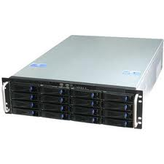








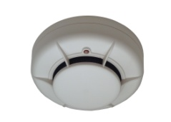
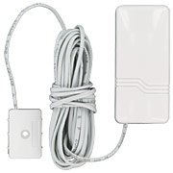

What is the Flex V3?
Video
2-way Audio
ARC
Full integration
Intruder detection
PE1800
Digital alarms
Audio
Video
IP Alarm Receiver
Monitor Computers
ENAI
Lopez Bello
Azuresoft
Software AG
Honeywell PE1800
GPRS
2A or 1A PSU
Hold-up buttons
PSTN
Ethernet
Telemetry
Configuration
Technical alarms
2-way SMS
Fire detection
Services
Automatic configuration
Automatic servicing
End user Support
Environmental detection
Installer

Slide 3
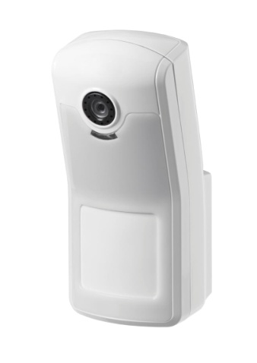
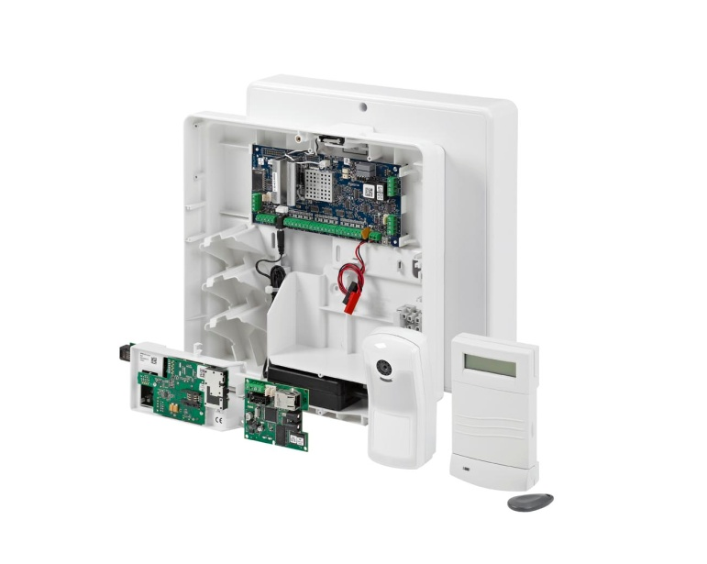
What can Galaxy Flex do for You?
Save significant cost on dual path, IP communications
  Fully integrated dual path solution with no recurring costs
  Full encryption and polling capability on both GPRS and Ethernet
Reduce false alarms, increase recurring revenue
  Flexible, competitive visual verification option
  Meets legislation and demands for better false alarm discrimination
Reduce engineer call outs
  Comprehensive remote maintenance and diagnostics tools
Reduce installation time and cost
  Fewer boxes to install
  Less wiring
  Comprehensive commissioning and diagnostics tools
Flex improves profitability for both Installers & ARCs

Slide 4

Alarm Signalling over GPRS and Ethernet
IP Receiver
Honeywell PE1800IP
Or
IP Alarms
3rd Party Compatibility:
Encrypted with polling
Manufacturer | Country | Status | Availability
Lopez Bello | ES | Complete | Roll-out started
ENAI | NL - 100% Mkt DK | Complete | End Feb 2013
Monitor (Sentinel) | UK – 85% Mkt | Complete | End Feb 2013
Azuresoft | FR, BE | Complete | Roll-out started
Honeywell PE | FR, ES | Complete | Roll-out started
Software AG | ES | In Testing | March 2013
ESI | FR | In Discussion | July 2013
GPRS
Flex Panel
Ethernet
Plus PSTN back-up on-board
This gives Flex a robust, secure, multi-path comms solution with wide market compatibility

Slide 5
$$ What does the New Comms mean? $$
UK Example – Recurring revenue
GPRS Module, with polling & PSTN Back-up
Cost to the ARC/installer with a 3rd-party communicator
Typical Dualcom costs added to panel
Installation costs £150 - £200
Device
PSU
Wiring
Connection
License + SIM – Per year: £30-£60
3-year total: £250 - £350
Cost to the ARC/installer with the Galaxy Flex Solution
Honeywell GPRS added to Flex panel
Device: £135
Installation costs:
Connection: Free
SIM Card – per year: £25
3-year total: £210
Full Flex system can be more cost-effective for the integrated ARC than competitor panel plus a 3rd Party Comms device

Slide 6
$$ What does the New Comms mean? $$
Generic Example – Non Recurring revenue
GPRS Module, with polling & PSTN Back-up – Installer cost
Cost to the installer with a 3rd-party communicator
Typical costs
Device (typical): 200€
Installation cost
(Wiring, boxes, PSU): 50€ (1 hour)
Total Installation cost: 250€
(On top of ARC subscription)
Cost to the installer with the Galaxy Flex Solution
Honeywell GPRS added to Flex panel
Device: 187 €
Installation cost
(Wiring, boxes, PSU) 10€ (12 minutes)
Total Installation cost: 199€
(On top of ARC subscription)
Cost benefits for installers through easier installation

Slide 7



Using the complete Flex V3 solution
GPRS
Primary or backup Path
Video
PE or Monitor Rx
GPRS Module
Alarms
Flex Panel
CMS / ARC Operator
PSTN Primary or Backup Path
RRI
Remote Servicing/ Maintenance
ARC
SUPERVISED PREMISES
End User Mobile App
(future)
END USER
System integration
Single communication package for all comms needs
Reduced costs
  Simple installation(no PSU, no output wiring, no external boxes)
  Option for upload//download over GPRS
Integrated visual verification
New sell-up features
  Future compatibility is built-in
Flexible communication technology options

Slide 8

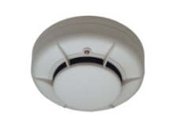



ARC visual-verification with PE1800IP
ARC/CMS Management software (FEP)
ARC
PE 1800 IP Receiver
Alarm code processing
IP Alarm & images
Alarm Code
Images
GPRS
FTP server
Flex Panel
Alarm code and video combining
Ethernet
Specific Image sequence
CMS / ARC Operator
ARC software developer | Country | Status
IBS | ES | Complete
Software AG | ES | In Test
Monitor Computers | UK | In Development
ESI | FR | In Discussion
Bold | ES | In Discussion
GUI
Alarm event (message with Video)
Highly Flexible visual verification solution

Slide 9
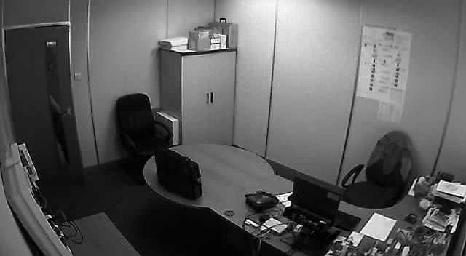


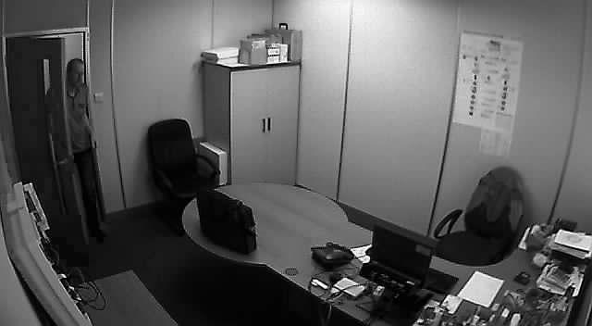
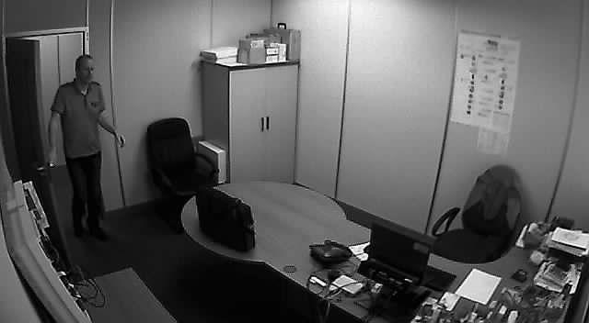
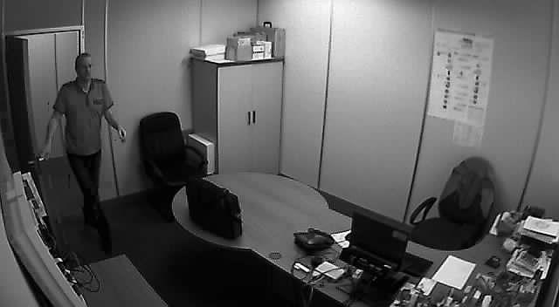
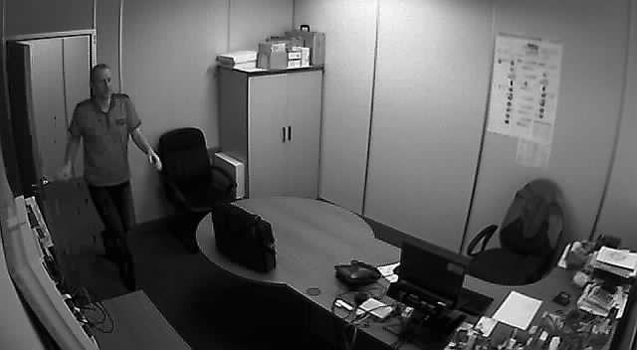

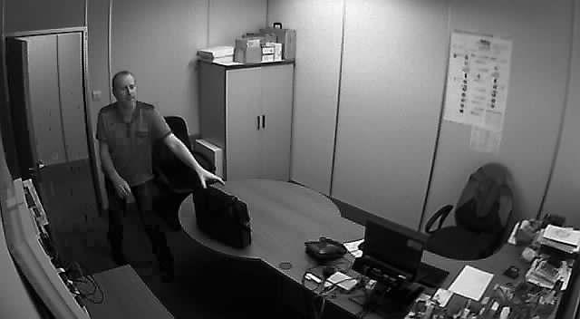

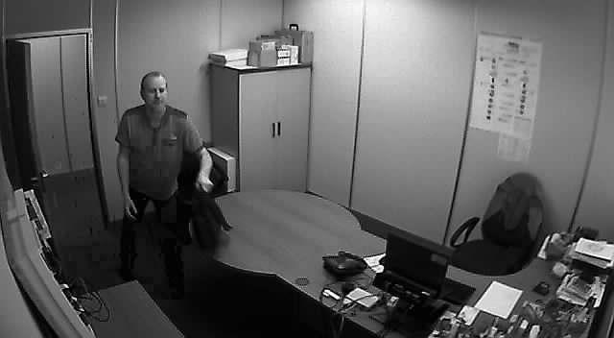
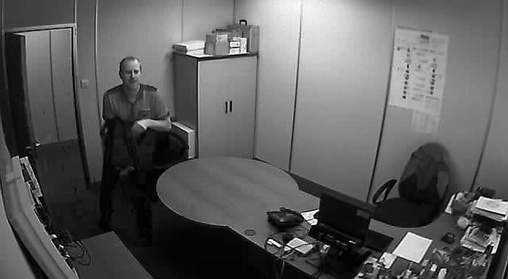
Video Example 1
Image Sequence (Slideshow)
  Black and white, high resolution
  4 pre-alarm images and 8 post alarm images.

Slide 10
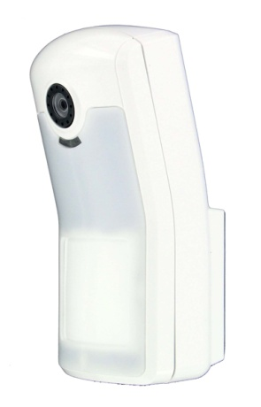
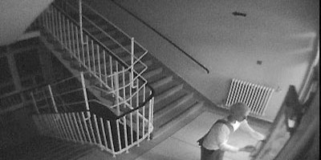

$$ So what does Visual verification mean? $$
Flex Visual Alarm Verification
  Designed to help reduce false alarms – but also verify real alarms!
  Delivers cost effective visual verification – removes the high price barrier
  Fully-Flexible – can be triggered from any other zone via programming
  Captures all alarm types, including Intruder, Fire and hold-up
  Easy to install – connects to the data bus like any other peripheral
  Meets the legislation requirements for video verification in Spain
  Growing market trend to use more reliable forms of verification
  $$ Improves speed of response for real alarms
  $$ Eliminate cost to end user of False alarm call-outs
  $$ Save time and resource of Guard response & emergency services
Flex removes the cost barrier to using the best form of alarm verification

Slide 11

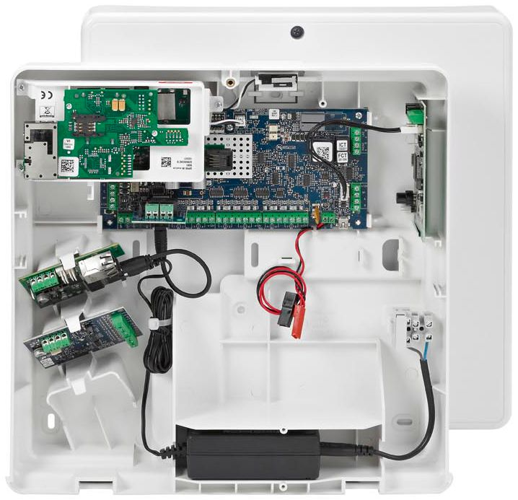
Reduce installation cost
Flexible, robust and capable box makes the difference:
Significant time savings on physical installation
  One box to install - save drilling & fitting time
  Installer-friendly moulded design
    Plastic construction allows radio inside
  Communications modules installed inside the box
  Wireless interface inside the box
  Plug together remove cabling & connection time and errors
  Hinged/removable lid adds convenience and saves frustration
  Save 30-60 minutes (typical) when installing wireless and/or IP communication modules = 25-50€ saving per install
GPRS Module
RF Portal
Tough and practical construction
  The box material is intended to help withstand installation damage better than metal boxes – it won’t scratch or dent when dropped
  Thick ABS walls gives the same EN impact resistance as metal box as verified by VdS
  $$ Less time on each job = more time for making new business
Ethernet module
7, 9 or 10Ah on ‘M’ version
17Ah on ‘L’ version
Sealed PSU

Slide 12


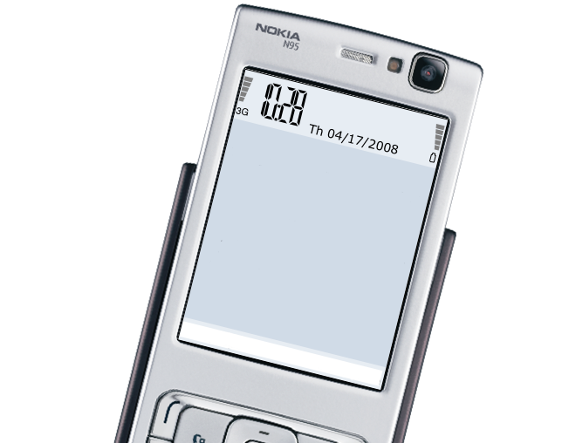
A user interface for every need
Range of User interfaces
  Choice is there to cover aesthetics and functional demands
  New, simple-to-use interface minimise errors
Remote User-Control via SMS
  Easier operation
  Feedback via SMS
  More peace of mind for the user
  Choice for every need
  Maximises satisfaction and security with ease of use
  $$ Less need to support the customer
  $$ Reduces costs due to false alarms
  $$ Customer more likely to close the deal
Alarm
1234 ARM 2_
Send Cancel

Slide 13
Galaxy Flex Market Plus Points Summary
Powerful new Comms solution – Dual path with encrypted GPRS/Ethernet
  Cost-effective comms for any installation
  Reduces CMS recurring costs
  Reduces Installation
  A platform that delivers the facilities to make recurring revenue
GPRS and Wireless options inside the control panel
  No need to mount extra boxes – faster installation = reduced cost
Camera PIR fitted to the data bus
  Flexibility to react to any alarm event via zone programming
  Reduces cost of false alarms
  Removes the cost barrier for implementing visual verification
Comprehensive, automatic Remote Routine Inspection over any comms path
  Save travel cost for the installer for system maintenance
Access to more advanced features compared to competitors
  Door Control, Timer scheduling, TouchCenter, Keypad

Slide 14
Order Codes
Item | Order Code
Flex 20 1A | C005-M-Ex
Flex 20 2A | C005-L-Ex
Flex 50 1A | C006-M-Ex
Flex 50 2A | C006-L-Ex
Flex 100 1A | C007-M-Ex
Flex 100 2A | C007-L-Ex
GPRS Module | A081-00-01
Ext Antenna cable (x 5) | A076-00-01
Ethernet Module | A083-00-01
Camera PIR | ISN3010B4
A range of virtual kits are also available.
Check regional price lists for details
Examples:
Panel + MK7
Panel + MK8
Panel + MK8 + GPRS
Ex | Regional variants
E1 | General Market
E2 | UK (AC Plug)
E5 | France (NF hardware)

Slide 15


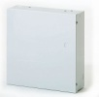



2013 Galaxy Flex Roadmap
Q1
Q2
Q3
Q4
Panels
Galaxy Flex V3
Tuxedo Galaxy
Galaxy Flex V3.01
With UK PA update
Galaxy Flex Metal box
Wired Video PIR
Peripherals
GPRS module
RF Portal MK4
Ethernet Module
Software
Remote Servicing Suite (update)
Smart App Server
PE SIA Video Support

Slide 16
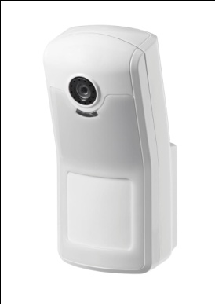
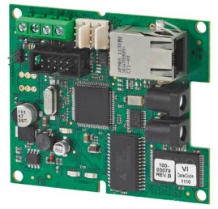
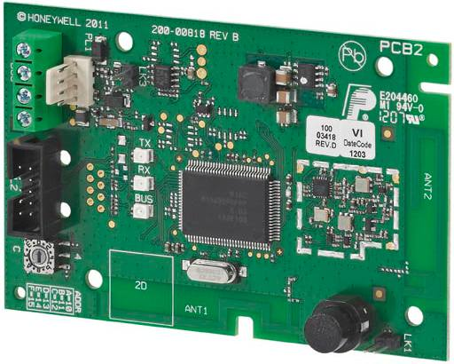
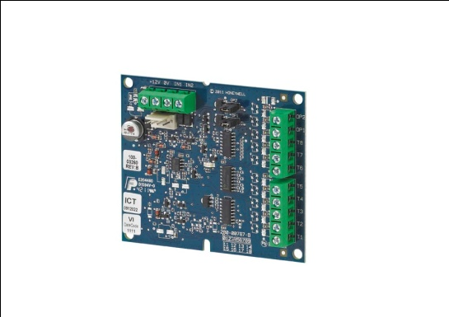
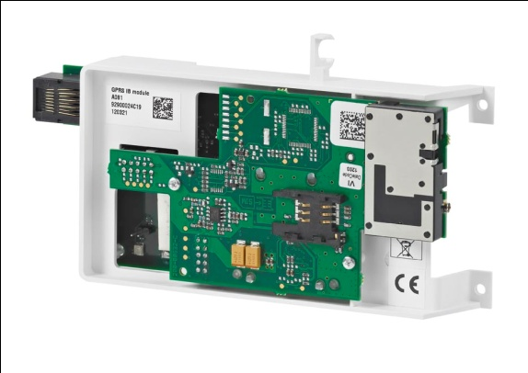
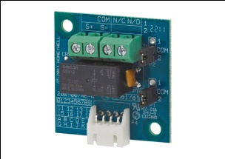
Appendix Galaxy Flex V3
Thank you for listening
Any Questions?

Slide 17
Change to AC Mains cabling
From June, all panels will be configured at the factory to have the AC power cable configured as shown in the picture, due to market demand.
The AC Plug will not be supplied but will still be available to order when required.
This will allow UK to merge with the general market variant E1

